Slide 1
Disaster Recovery for Kubernetes (system level)
Zach Chih, Advantech

Slide 2
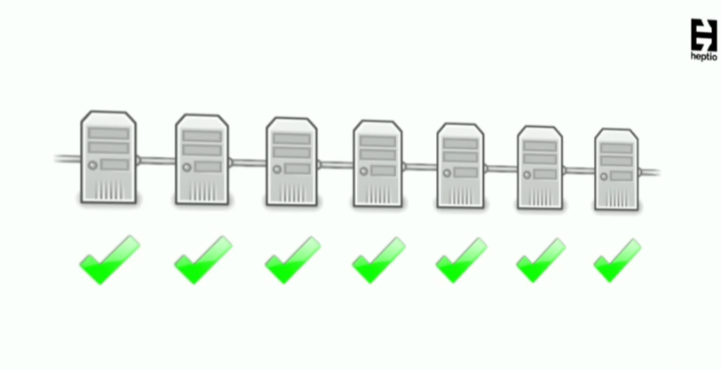

Slide 3


Slide 4
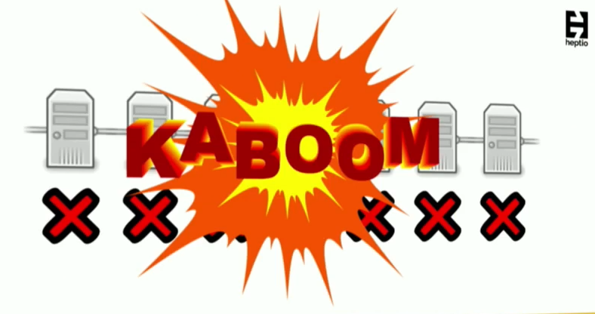

Slide 5


Slide 6
Why?
There are many use cases why you need to backup the state of your cluster.

Slide 7
Why?
To recover from disasters
  such as someone accidentally knocking off a namespace
To test upgrades
  one can quickly snip up a new cluster from backups and test scenarios such as kubernetes upgrades or if you are using a service mesh such as istio upgrades
Replicate your environment
  Once you’ve a state of k8s, you can selectively choose what to re-create and can easily replicate that into your other environments such as staging.
Scheduled migrations
  Say, you want to migrate from one cloud provider to another, creating a new cluster and re-playing the kubernetes state from backups shouldn’t be a big deal.

Slide 8
Levels
Application Level
System Level

Slide 9
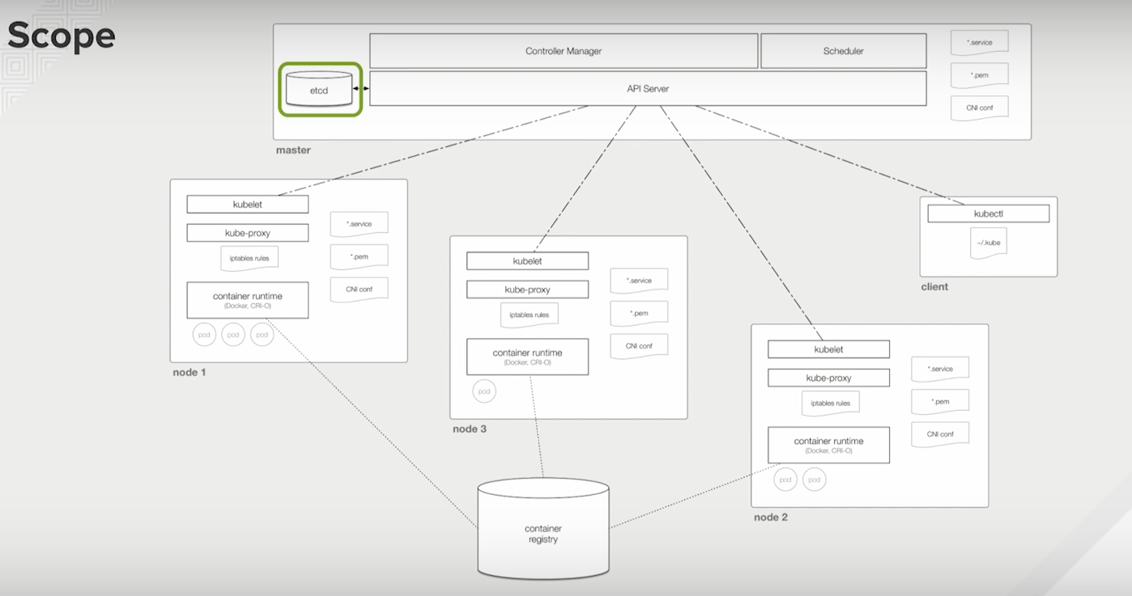

Slide 10
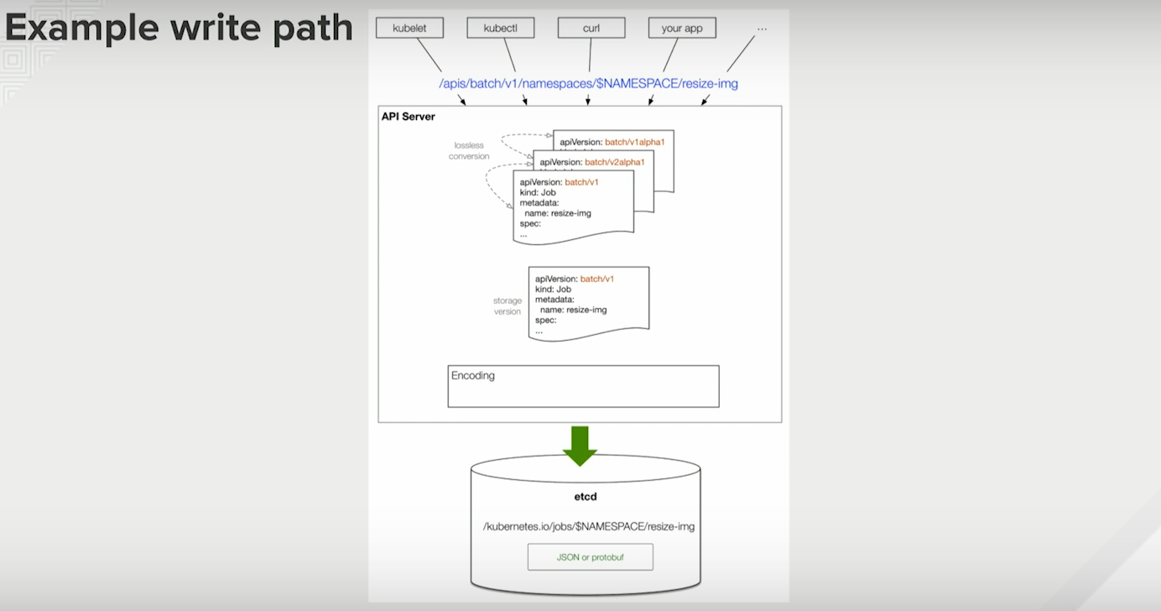

Slide 11


Slide 12
How?
Backup your resources!!
Every resource in kubernetes platform is treated as an API object. So, you need to backup all k8s resources as configs.
Then you could happily restore them from any disasters!!

Slide 13
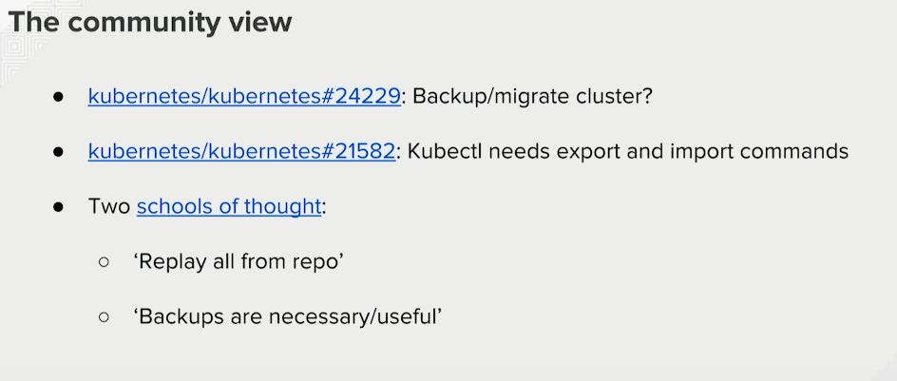

Slide 14
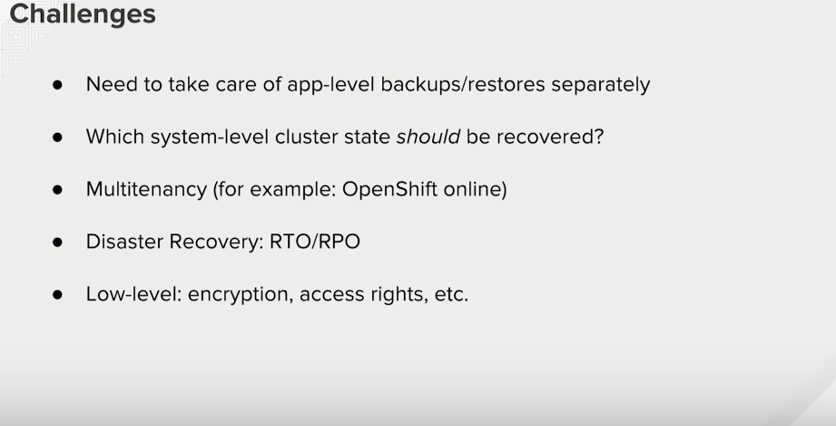

Slide 15

Private Repository
ChartMuseum
  an open-source, easy to deploy,
  Helm Chart Repository server.

Slide 16
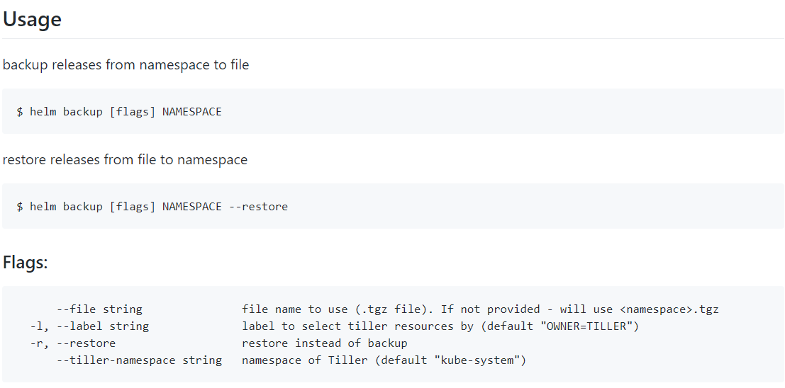
Helm Backup
This tool help users to perform backup/restore of releases in a namespace to/from a file
  /etc/backups
    With permission control

Slide 17
Local Charts
/etc/charts
  Includes all charts we deliver
  With permission control

Slide 18
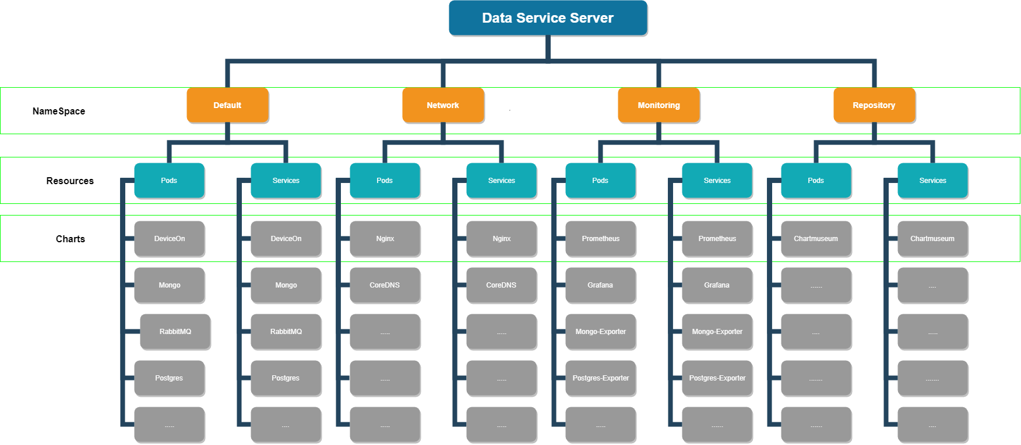
When you are fine….

Slide 19
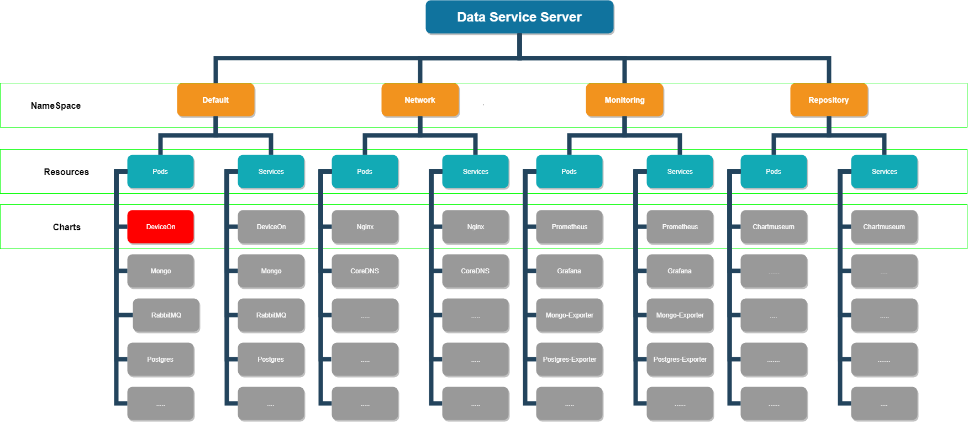
Disasters: one resource down

Slide 20

Solved: one resource down
Most Causes:
  Wrong Config
  Out of resources
Solution
  Kubectl to fix

Slide 21

Disasters: one app (chart) down

Slide 22

Solved: one app (chart) down
Most Causes:
  Wrong Config
  Out of resources
Solution
  Restore from private repo
  Restore from local chart

Slide 23
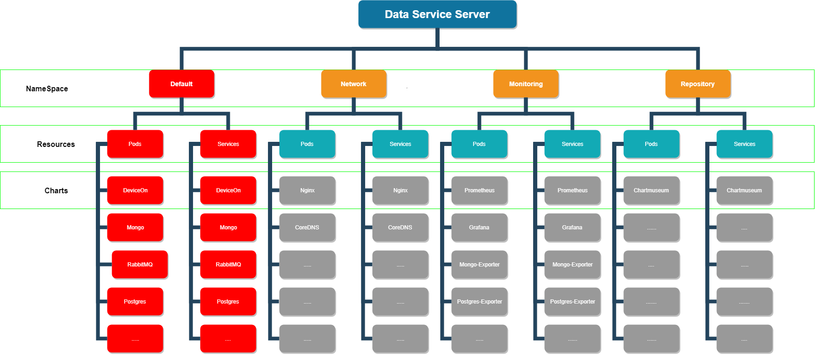
Disasters: one namespace down

Slide 24

Solved: one namespace down
Most Causes:
  Wrong Actions
  Out of resources
  Dependent Problems
Solution
  Restore from backups

Slide 25
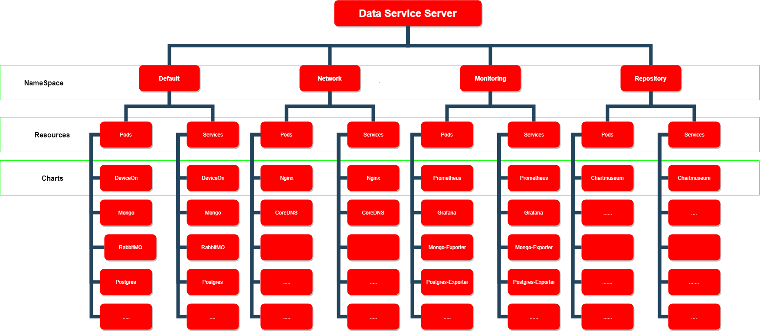
Disasters: the whole DSS down

Slide 26

Solved: the whole DSS down
Most Causes:
  K8s/Ceph down
  Unhealthy Platform
Solution
  Fix the platform first!!
  Then restore from backups

Slide 27

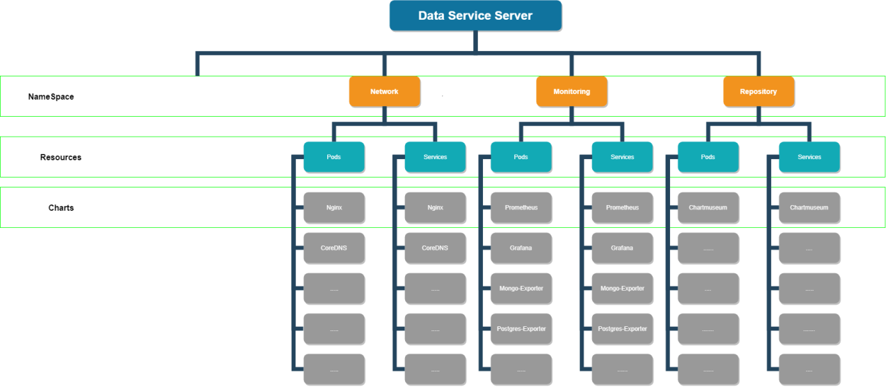
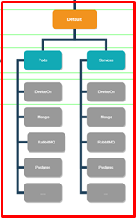
Migration
Namespace
Entire Environment
Production(Department B/Azure)
Stage(Department A/GCP)

Slide 28
Summary
RD/AE
  Help customers quickly recover the environment from the disasters.
  Help customers migrate their environment to another.
Customers
  Backup their applications beforehand.
  Recover from the disasters on their own.
  Migrate the environment to another on their own.

Slide 29


Slide 30
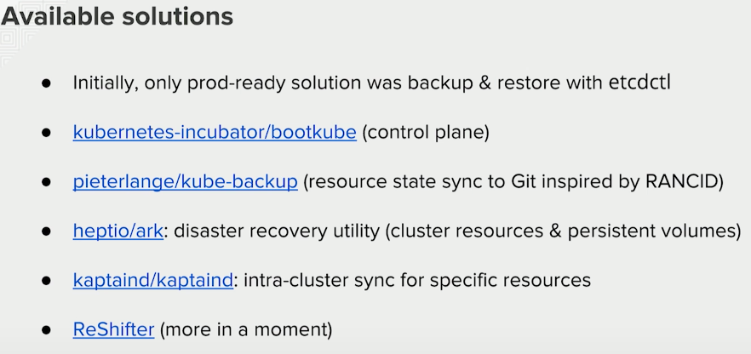
Other Stories

Slide 31
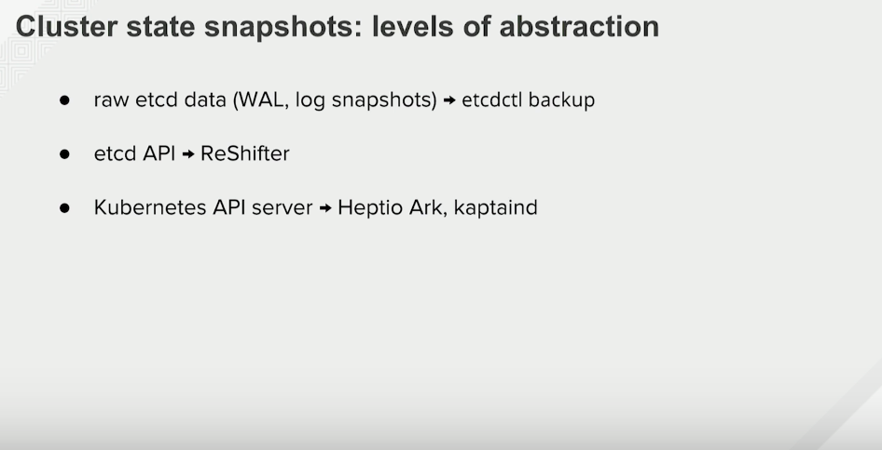

Slide 32

Another Story…. Velero
Velero (formerly Heptio Ark) gives you tools to back up and restore your Kubernetes cluster resources and persistent volumes. Velero lets you:
  Take backups of your cluster and restore in case of loss.
  Copy cluster resources to other clusters.
  Replicate your production environment for development and testing environments.

Slide 33
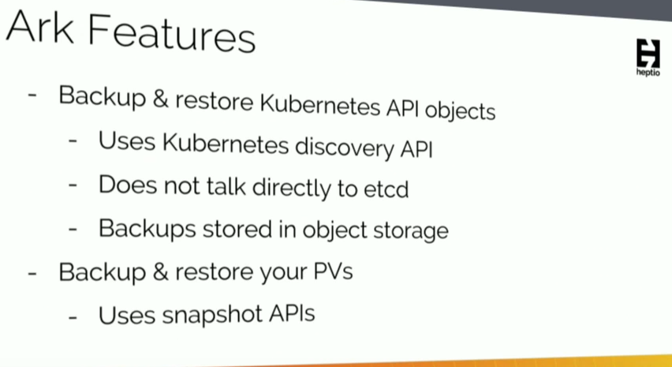
Another Story…. Velero

Slide 34
Why Not?…. Velero
Not Natively support Ceph (Rook-Ceph)
Not support Helm (Control/Deployment flow will not be easy)
Limited disk space
Unexpected backup size and must be big!
Maybe in the Future

Slide 35
Go Together,
We Go Far and Grow Big

